Slide 1
Big O Notation: Program Run Time Estimation
John Wei

Slide 2
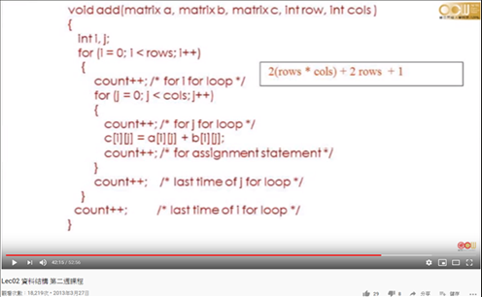
Instructions Counting
To compare different algorithm properly, counting instructions instead of real time scaling. (Ignoring effects come from CPU, compiler, language ..etc.)
The instruction of this program:
2 ( m * n) + 2 * m + 1
But:
1. It is wasting time to count each instructions for program.
2. In large scale of input data,
2 * m + 1 is meaningless to 2 ( m * n)
=> Asymptotic Behavior

Slide 3
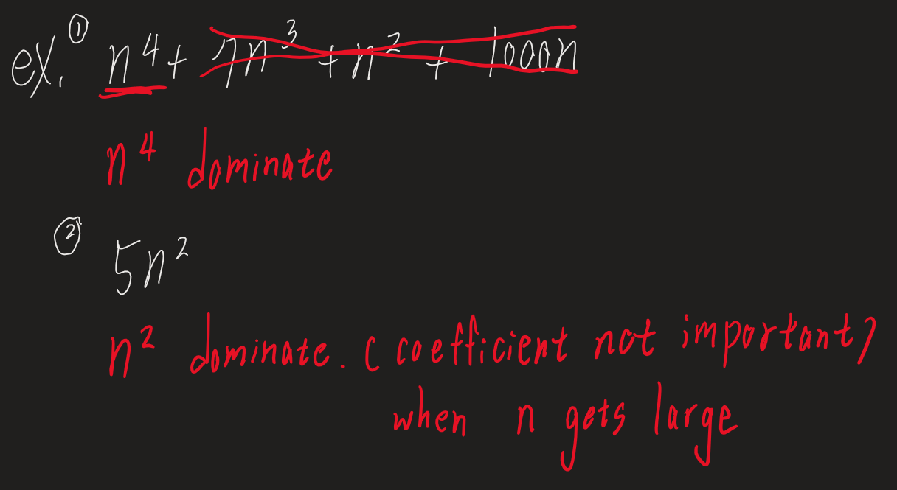
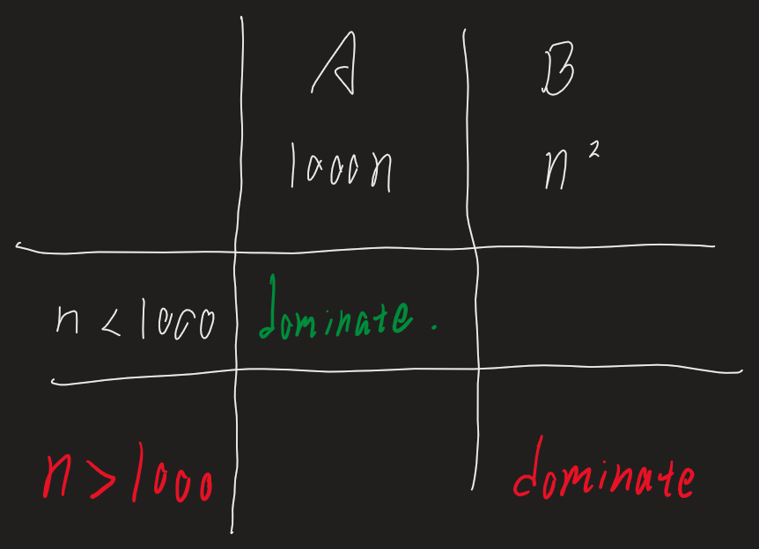
Asymptotic Behavior
This filter of "dropping all factors" and of "keeping the largest growing term" as described above is what we call asymptotic behavior.
It's reasonable to expect that different programming languages will yield different factors when we count their instructions.
http://discrete.gr/complexity/
We use dominant term to describe number of instructions.

Slide 4
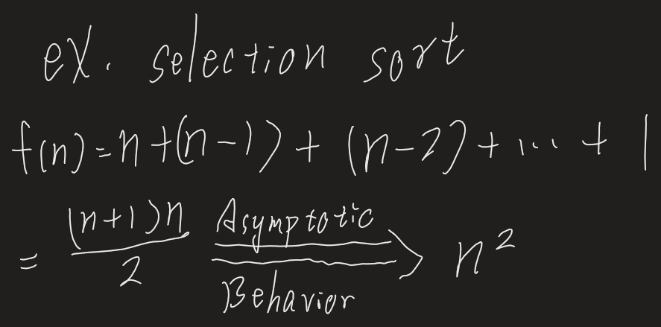
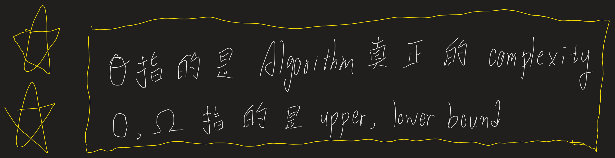
Complexity of a program
We use asymptotic behavior to help us simplify number of instructions. But what we get after the behavior? Is it less than or greater than the origin?

Slide 5
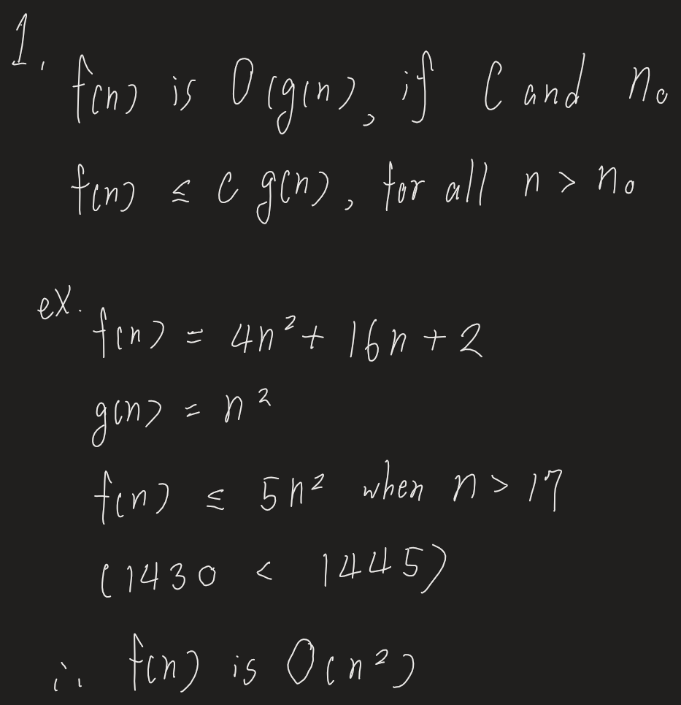


Big O Notation
The minimum upper bound of program

Slide 6
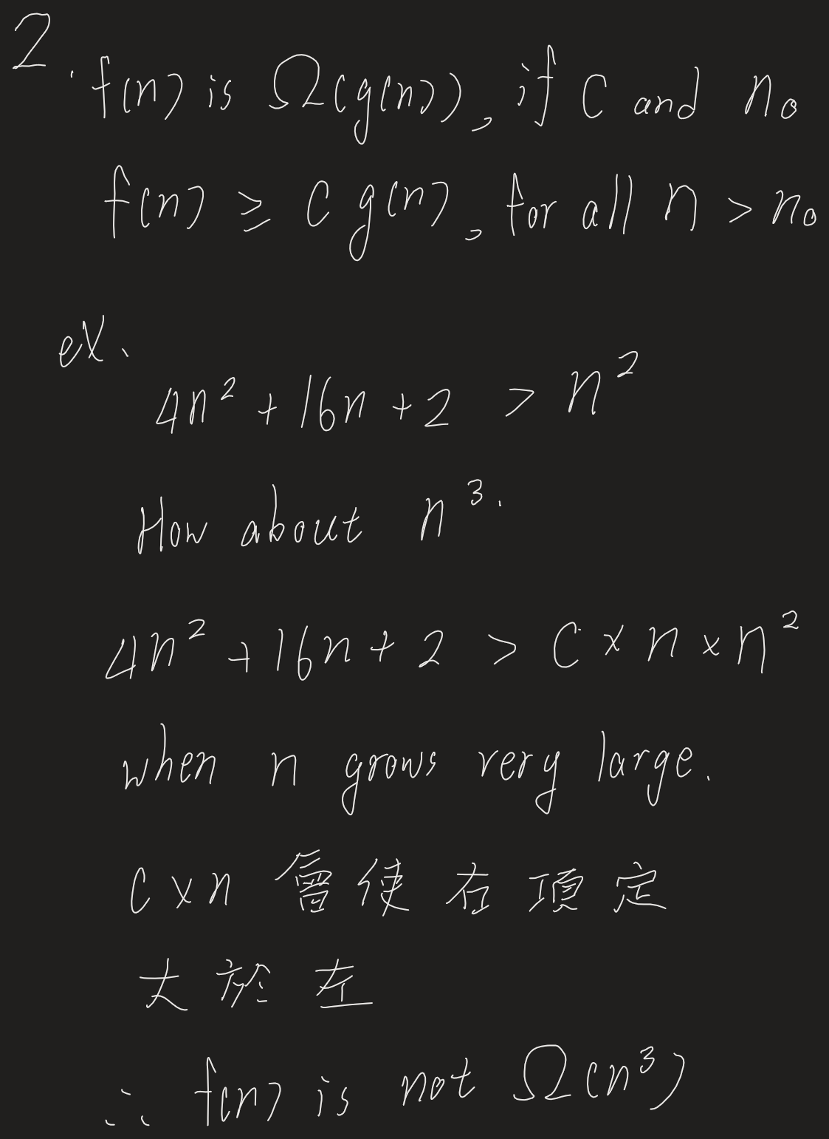


Omega Notation
The maximum lower bound of program

Slide 7
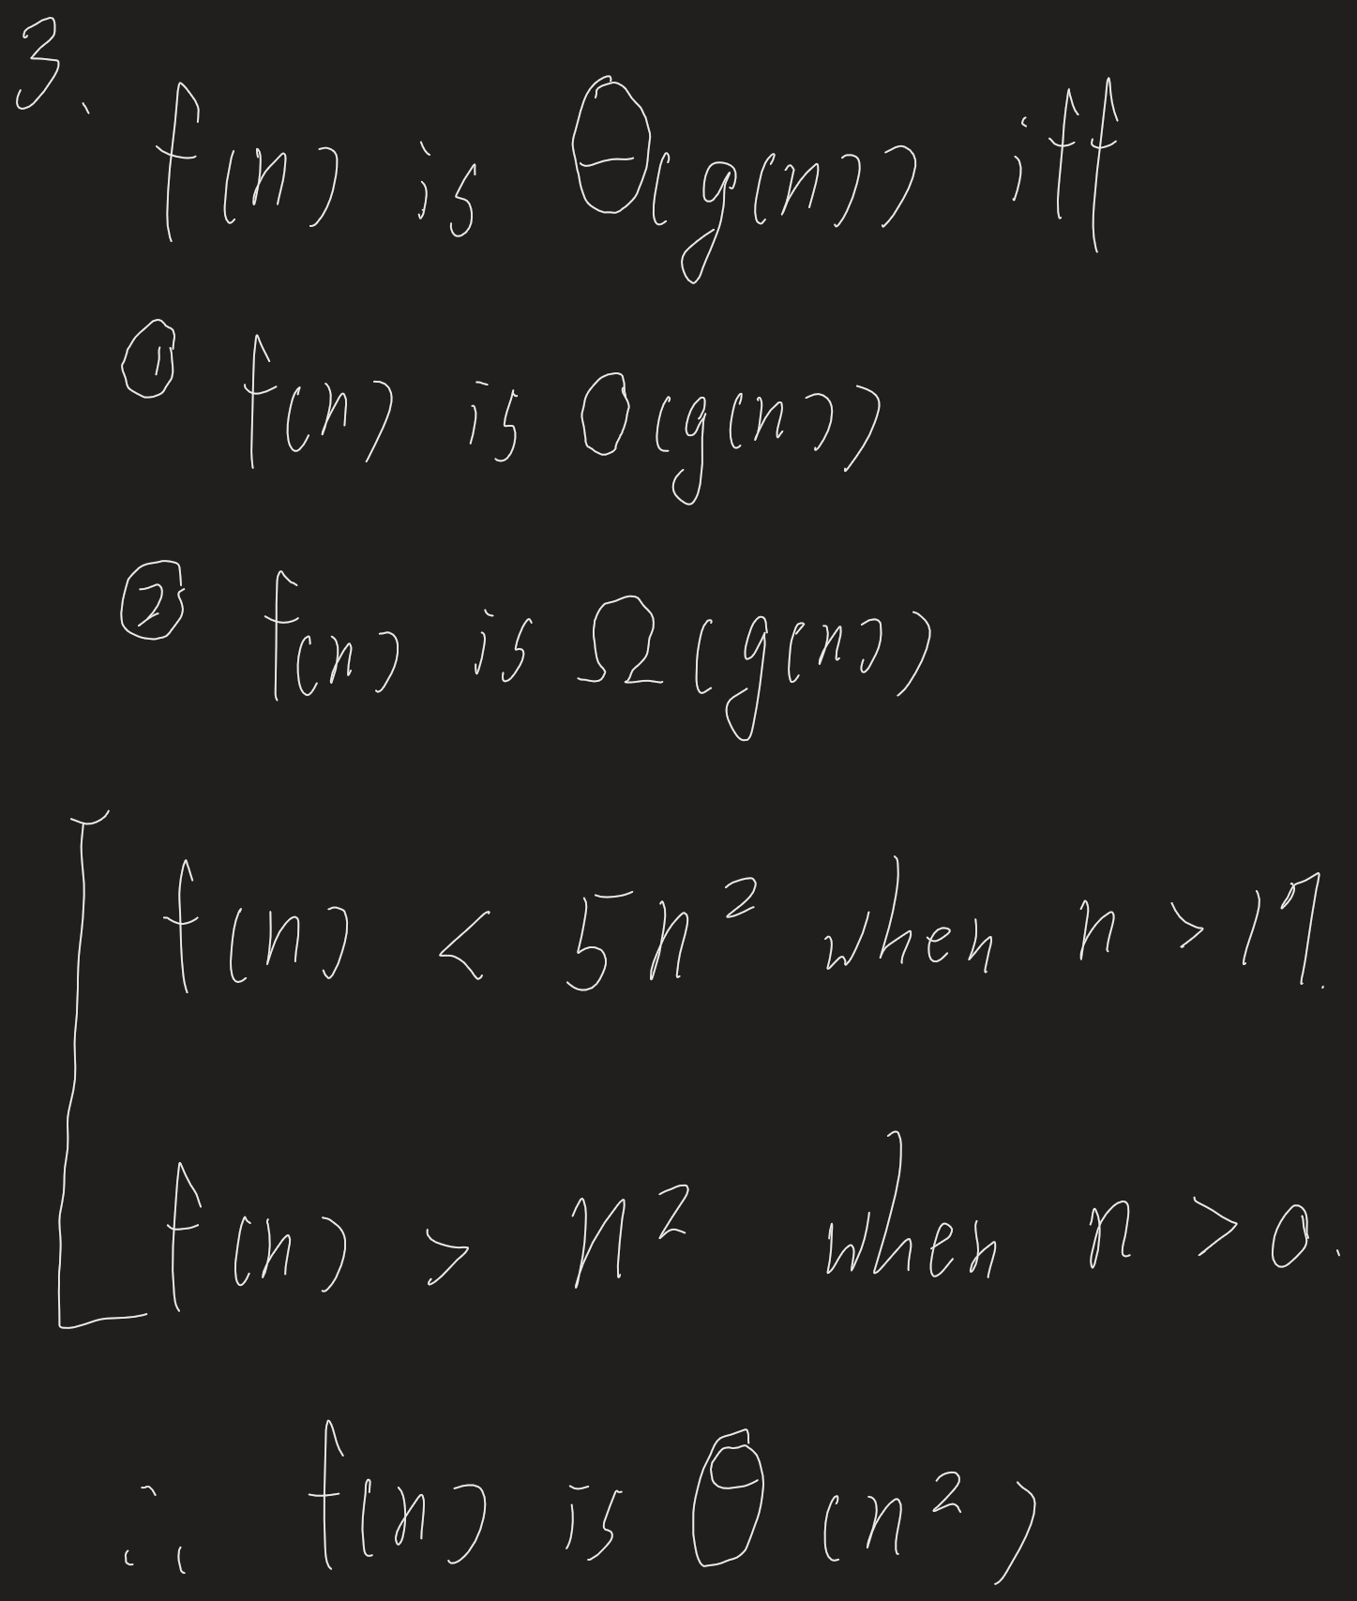
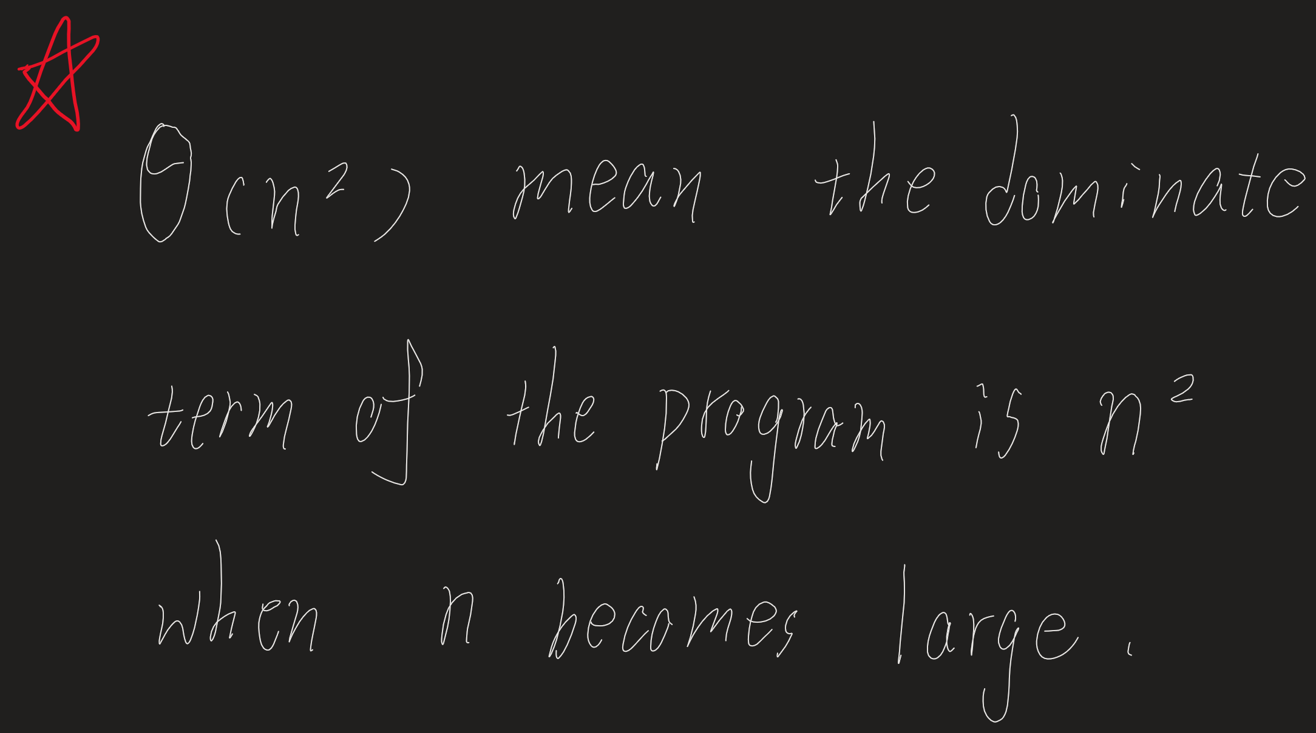

Complexity of a program

Slide 8
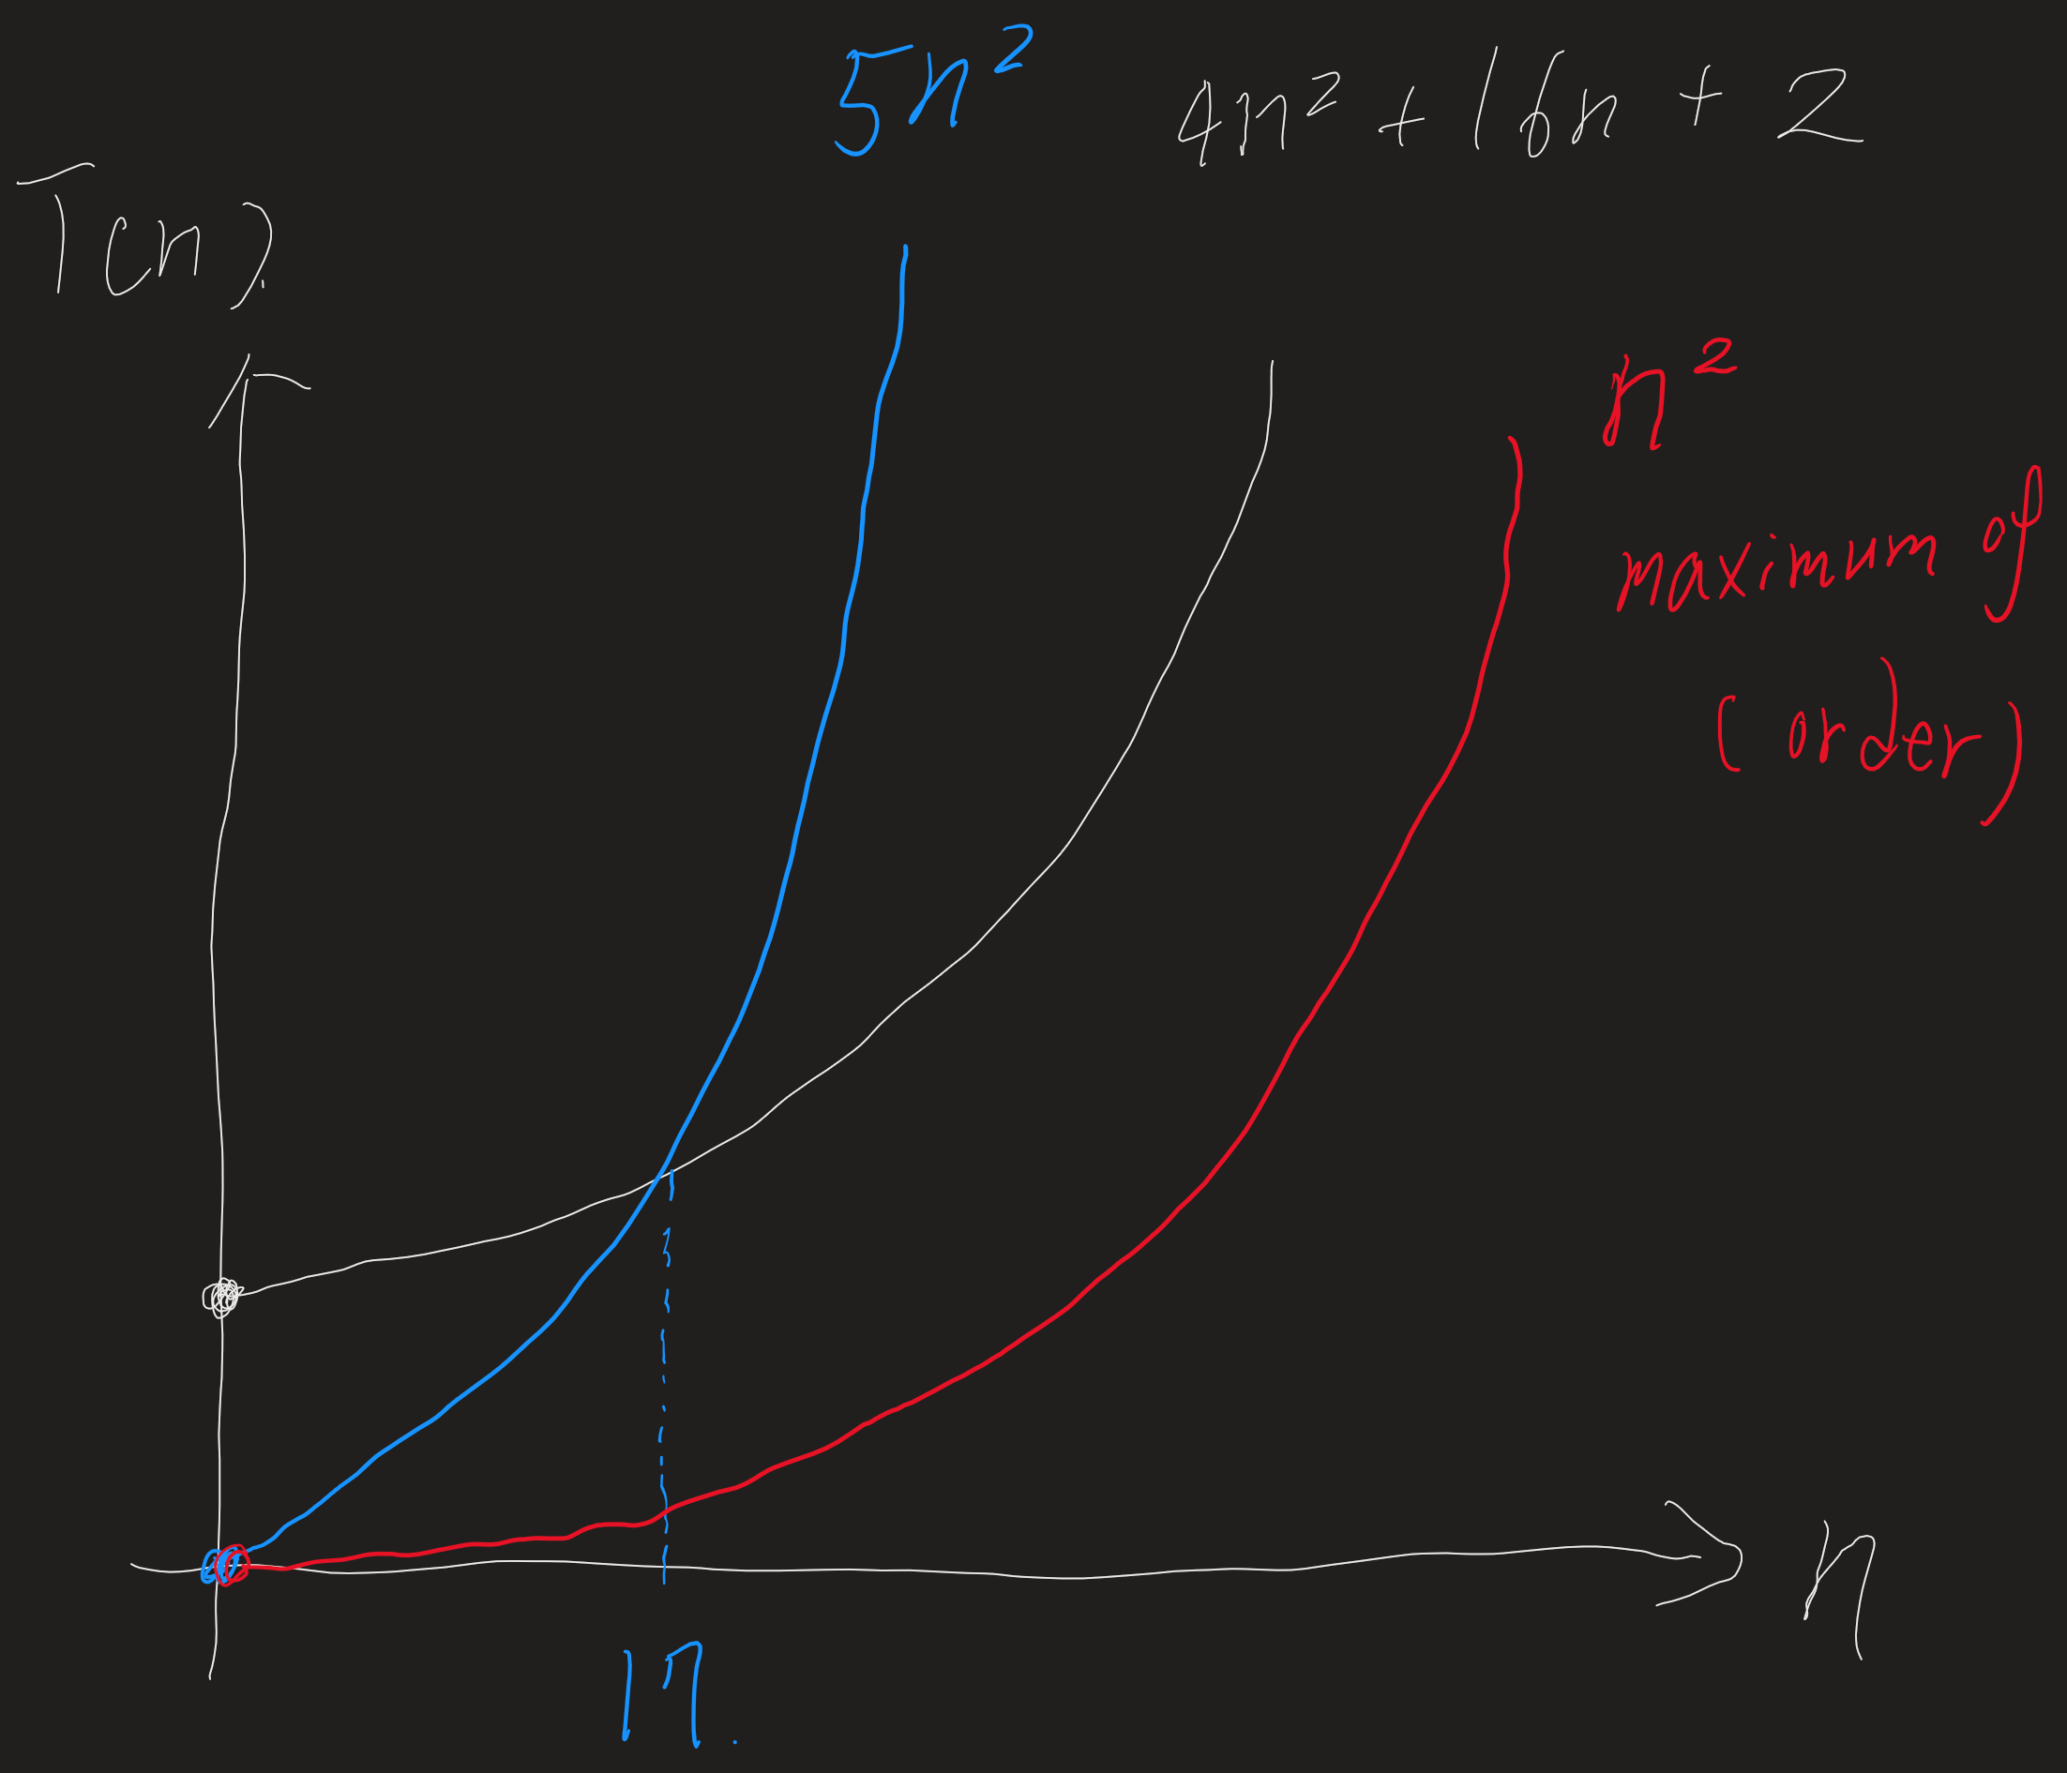
Complexity of a program

Slide 9
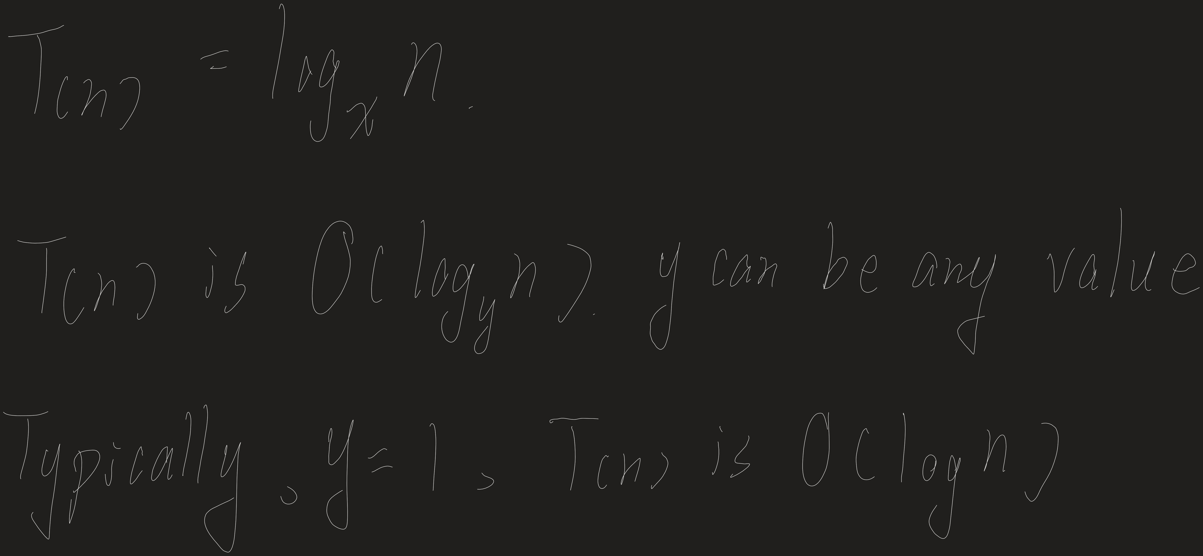
Logarithmin Complexity

Slide 10
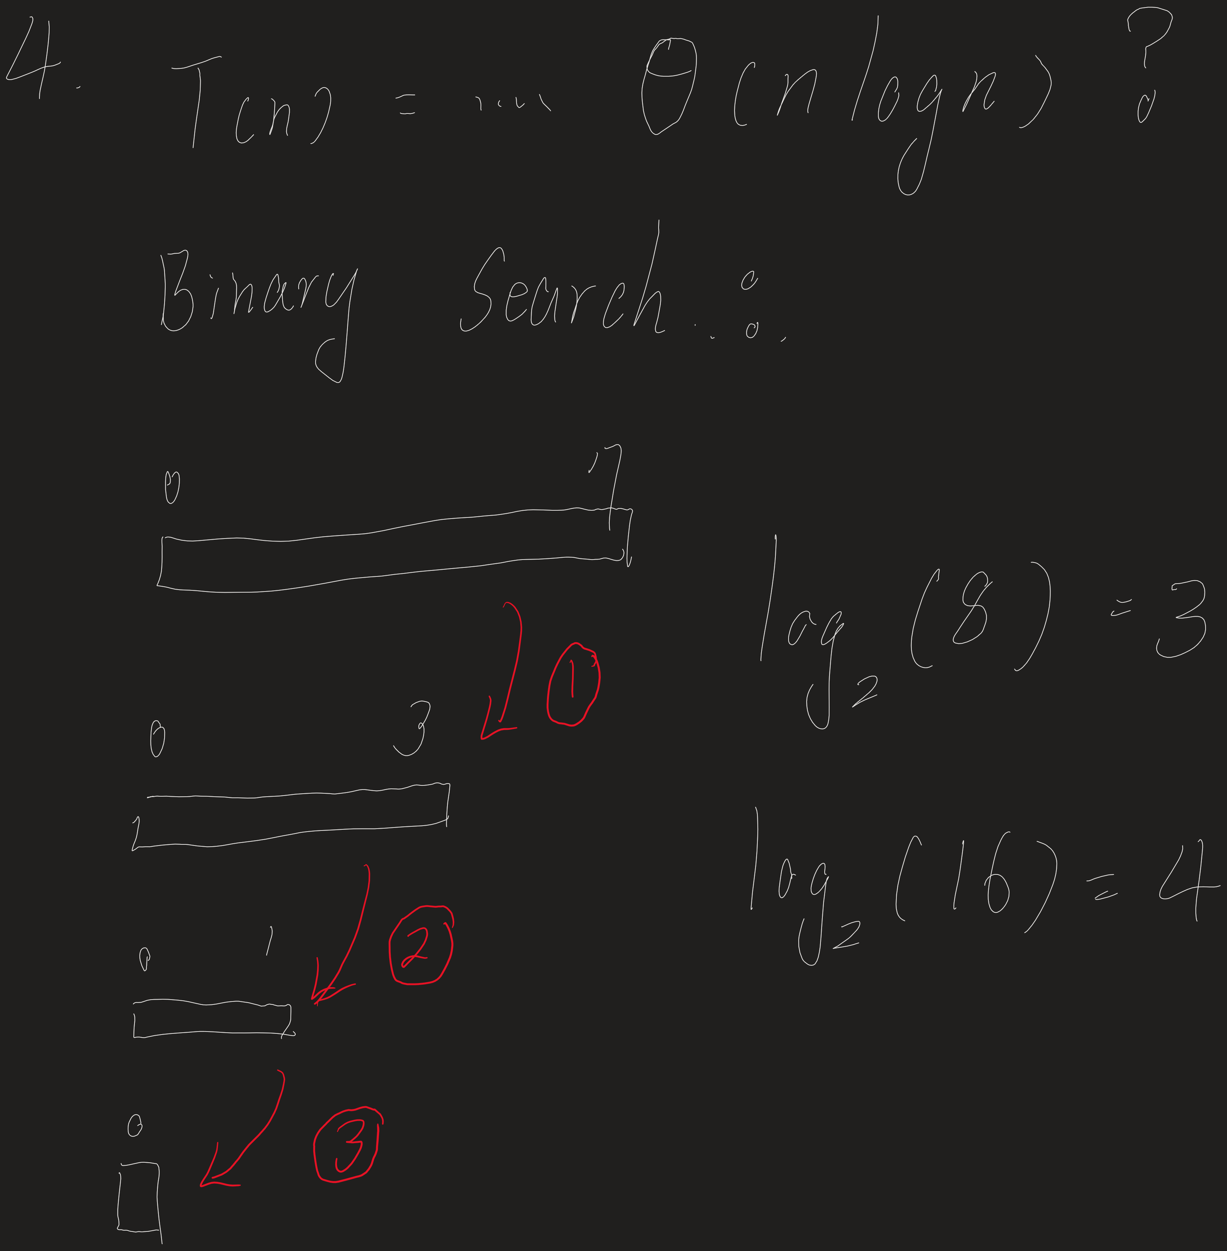
Logarithmin Complexity

Slide 11
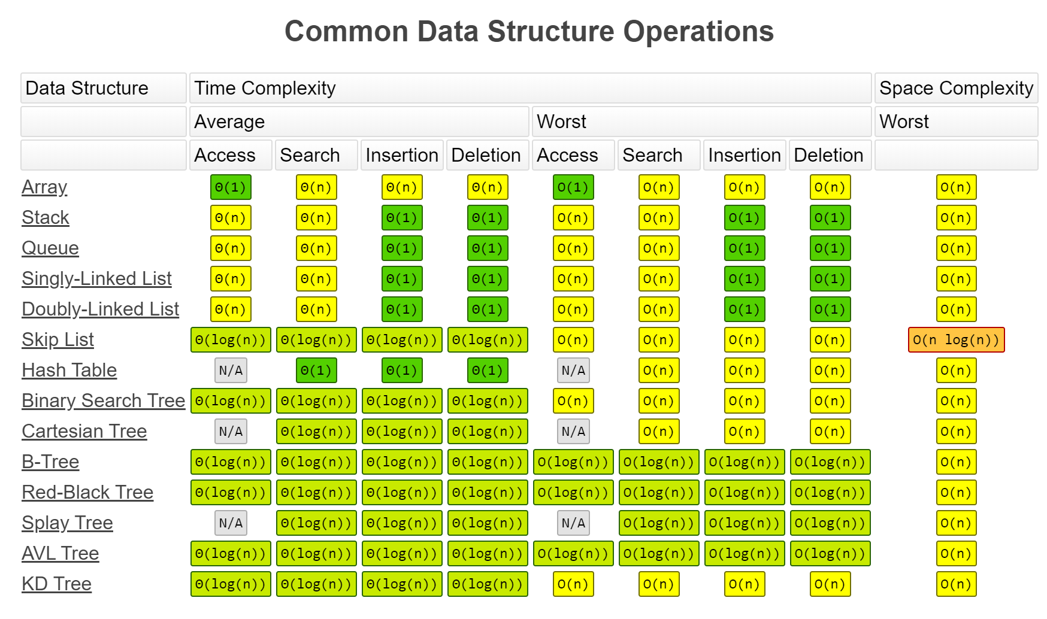
Cheating Sheet

Slide 12
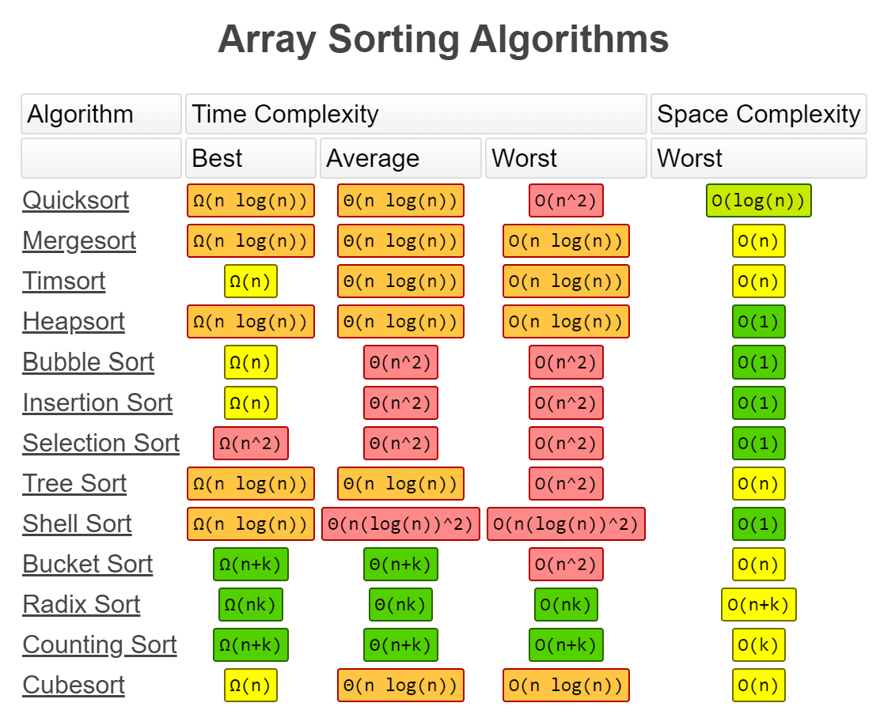
Cheating Sheet

